Slide 1

Feedback for Parent Carer Forum
Neuro-Developmental Services
Wigan Borough

Slide 2

Thank you for sharing your experiences with us. You said…………
You are Exasperated &
frustrated
You feel like you are always chasing for information
Remain unclear on timeframes
Tourette’s..
There is
No Pathway
You have been here before in 2018 & are no further on

Slide 3

What you asked from us …..
What’s covered by the pathway
Provide flowchart of pathway with timeframes
Provide contact numbers

Slide 4
What have we done?
Clear flow chart
The neuro developmental steering group have mapped the current system and devised a flowchart, this is NOT a CLINICAL pathway, but is a way to hopefully visually demonstrate what systems are in place during your journey.
Contact List
The steering group have devised a contact list of the systems involved and how/where to contact them
What is covered by the system…this is not a ‘pathway’
As above this is not a clinical pathway but a mapping of the current system including -
Referral/entry point and a brief description of what can be expected for
School Age -ASC (Autism Spectrum Condition)
School Age -ADHD (Attention Deficit Hyperactivity Disorder) from school starters up to 17yr 6months.
Early Years - Children 0-5 years with a significant delay within an area of their development which includes all possible neurodevelopmental conditions
School Age Tourette’s

Slide 5
Cont…..
Timeframes –guidance for some areas of health e.g. 18weeks referral to treatment time- Consultant led .
We have also …
Mapped the current training on offer across the services. We can add this to the local offer
The Neuro developmental pathway manager has also mapped out useful services and website information which again can be added to the local offer

Slide 6
Mapping of current Neuro-Developmental services
We found, just like you said….
There are different referral routes in (GP/ School/other professionals)
You may get referred to different services (Paediatrician/Therapy services (Occupational Therapy/Physio/Speech And Language Therapy) /Educational Psychology/Early Years)
Variable timeframes up to point of diagnosis/non diagnosis
Unclear around what is the pathway

Slide 7
Draft mapping of the system
& contact info

Slide 8
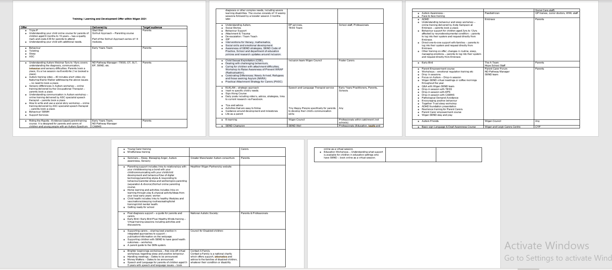
Training mapping

Slide 9
Continuing forward you also asked …
Next 12 months
Clinic letters and information clearer
Pre diagnostic support
Useful co-produced information pack upon diagnosis
Post diagnostic support/signposting
Clinic letters and information clearer
Clarity on CAMHS interventions
All included and clear on the Local Offer.

Slide 10
Better together
Look at where we would like the system to be
Clearer timeframes to be integral to the system
The ND pathway manager & coordinator are now in post
Hold a focus group to understand more about your lived experience with Tourette’s
Update the local offer with any information we co-produce
Keep this work ongoing within the SEND Transformation plan
Make a difference together & improve our support offer
Continue to work together to co-produce a pathway and improve the our systems/communication

Slide 11
Key Themes – Moving on across the pathways for the vision
To develop a Single Point of Access (SPoA) so that all referrals are made into one singular point
To develop a clear referral criteria with guidance/referral pack for the professionals referring into the service
To develop and implement pre-diagnostic support. Waiting times from the point of referral to diagnosis can often be a significant amount of time and those children/young people still require that support
To develop and implement post-diagnostic support for children/young people after they have received their diagnosis in terms of next steps and support available
To develop and implement non-diagnostic support as not everyone will receive a diagnosis but will still require additional support
To develop a report that can be shared with families regarding their outcome explaining how the panel/clinician has to come to that conclusion
To develop and deliver increased staff training/upskilling so that the workload can be shared
To have systems that work together and align
To explore pre-referral interventions and the pathway starting in the community

Slide 12
Key Themes – Meeting Chat
To consider the point of referral from GP to diagnosis
To explore pre-referral interventions; what are these and how do they factor in?
To explore pathways starting in the community
To develop a more effective triage system – some referrals go through to panel that should have never gone there
To better communication between Primary and Secondary Care, the wider team, Health Visitors, School health etc.
To explore reducing the number of professionals needed to raise concerns from 2 to 1 for the referral to be triggered
Confirm whether the assessment for ADHD is relating to learning difficulty or learning disability or both
To factor in transition across all 4 pathways
To clarify if a child isn’t in Early Years, how they can get access to the pathway
To explore the post-diagnostic offer covering all ages
To include Primary Care in education sessions

Slide 13
Next Steps…
The lead for each pathway to develop an implementation plan and bring this back to the next meeting. The plans will then be used to feedback to this group regularly on the progress of this work

Slide 14
Thank you
Your views really do matter, so please continue to work with us and share your thoughts.
Together we can make the difference for our children and young people/families.

